Slide 1
Corner Detection
COMP 4900C
Winter 2008

Slide 2

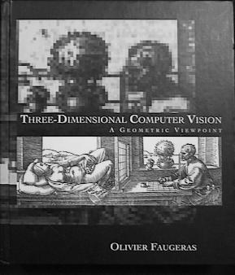
Motivation: Features for Recognition
Image search: find the book in an image.

Slide 3







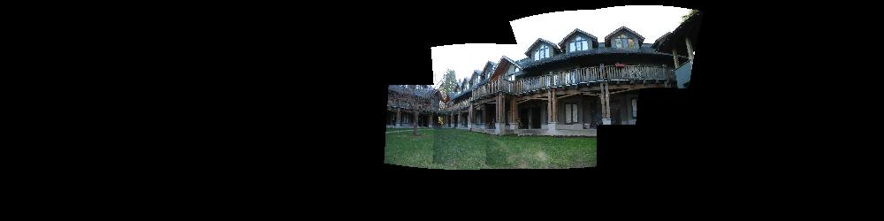
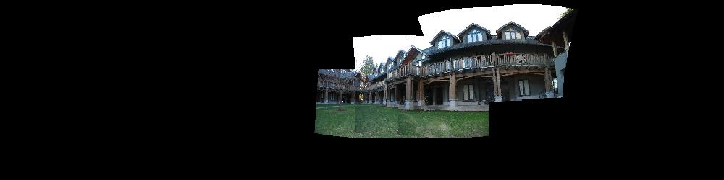
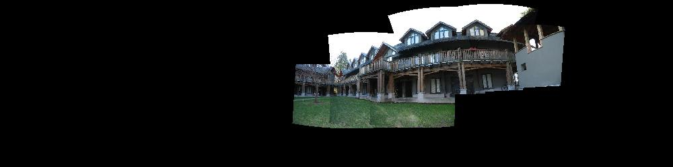
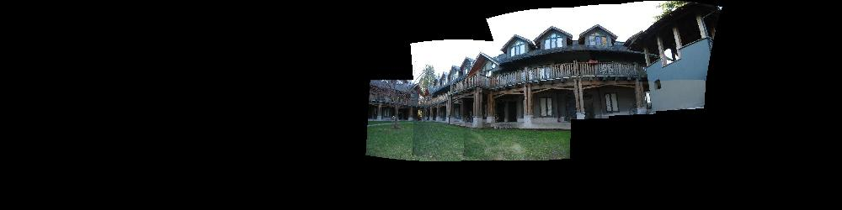
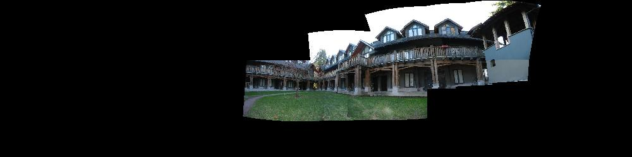
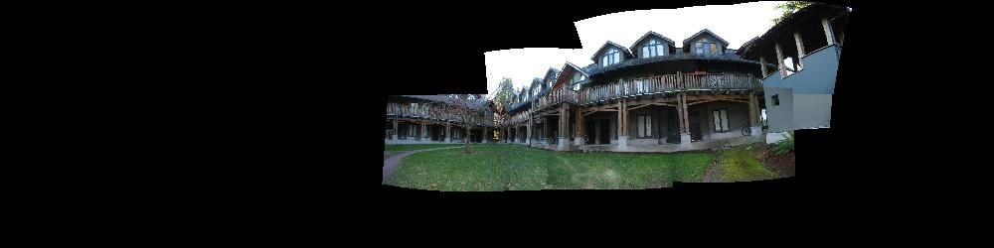
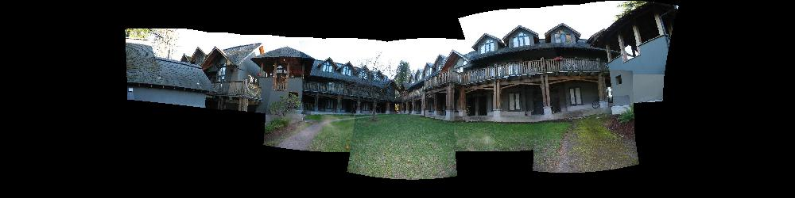
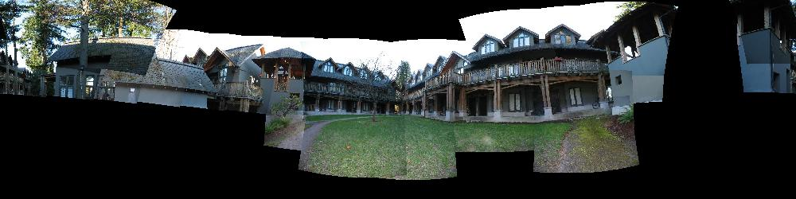
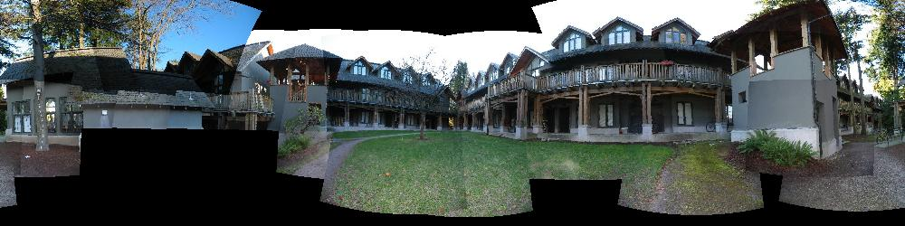
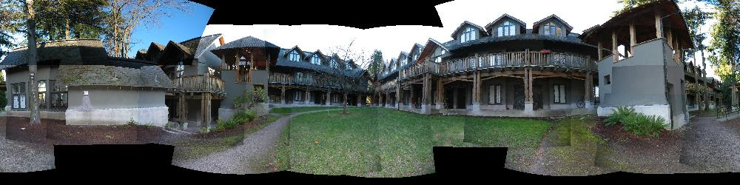
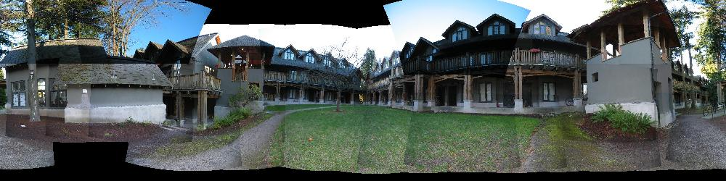
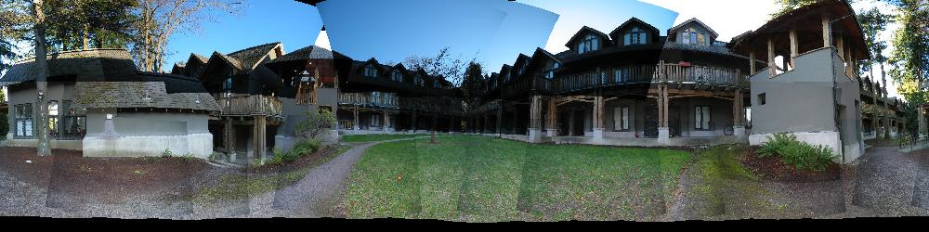
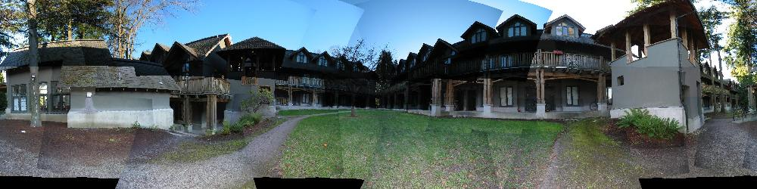
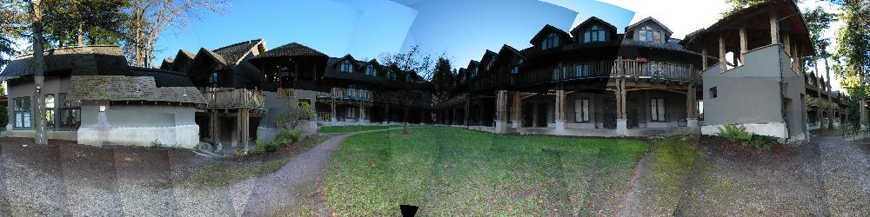

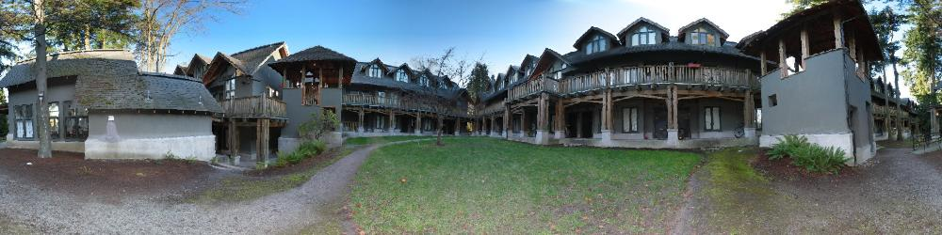
Motivation: Build a Panorama
M. Brown and D. G. Lowe. Recognising Panoramas. ICCV 2003

Slide 4
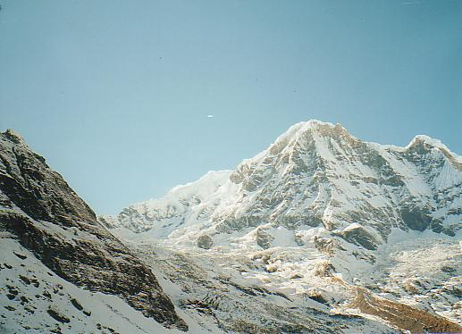
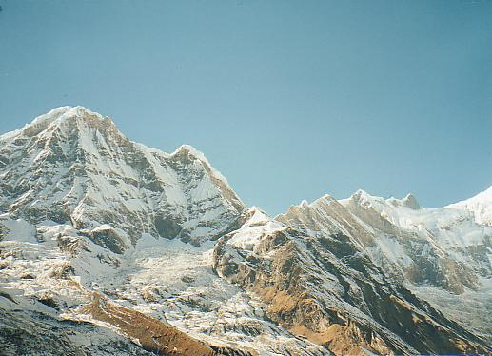
How do we build panorama?
We need to match (align) images

Slide 5
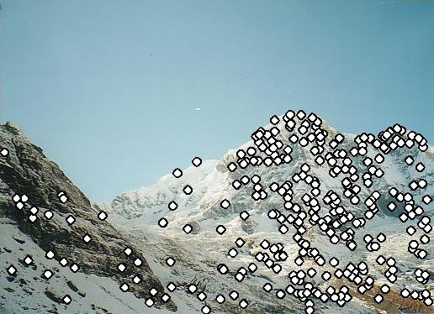
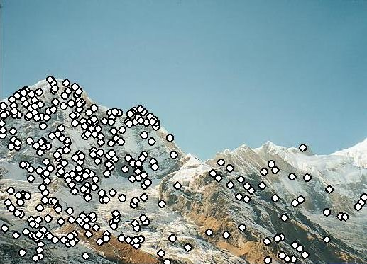
Matching with Features
Detect feature points in both images

Slide 6
Matching with Features
Detect feature points in both images
Find corresponding pairs

Slide 7
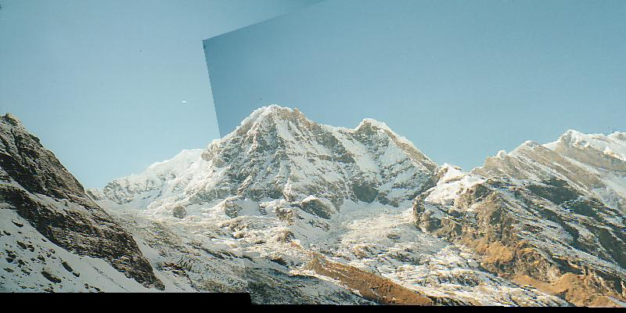
Matching with Features
Detect feature points in both images
Find corresponding pairs
Use these pairs to align images

Slide 8
More motivation…
Feature points are used also for:
  Image alignment (homography, fundamental matrix)
  3D reconstruction
  Motion tracking
  Object recognition
  Indexing and database retrieval
  Robot navigation
  … other

Slide 9
Corner Feature
Corners are image locations that have large intensity changes
in more than one directions.
Shifting a window in any direction should give a large change in intensity

Slide 10
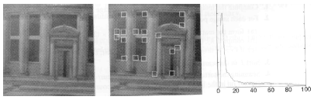
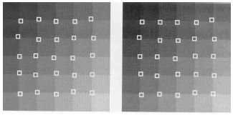
Examples of Corner Features

Slide 11
Harris Detector: Basic Idea
“flat” region:
no change in all directions
“edge”:
no change along the edge direction
“corner”:
significant change in all directions
C.Harris, M.Stephens. “A Combined Corner and Edge Detector”. 1988

Slide 12
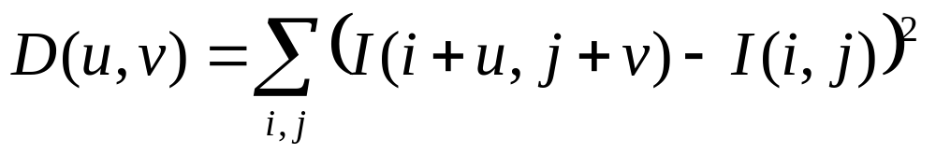



Change of Intensity
The intensity change along some direction can be quantified
by sum-of-squared-difference (SSD).

Slide 13
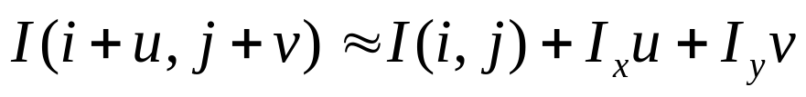
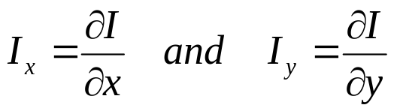
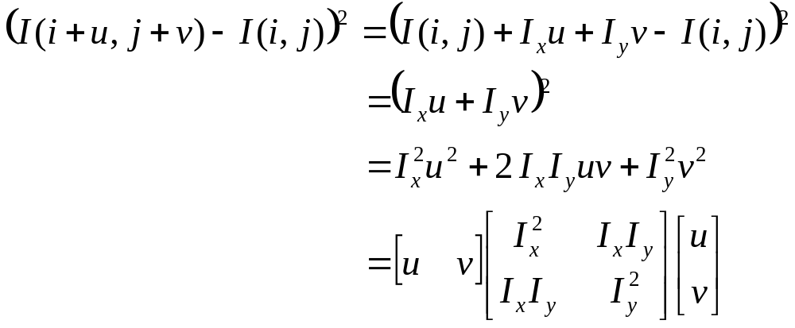
Change Approximation
If u and v are small, by Taylor’s theorem:
where
therefore

Slide 14
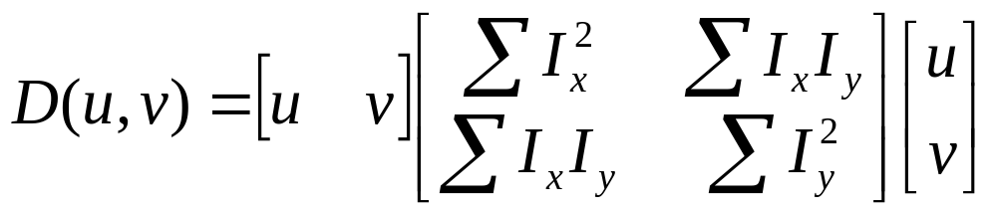
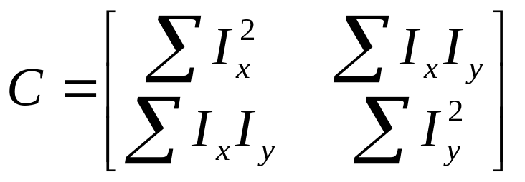
Gradient Variation Matrix
This is a function of ellipse.
Matrix C characterizes how intensity changes
in a certain direction.

Slide 15
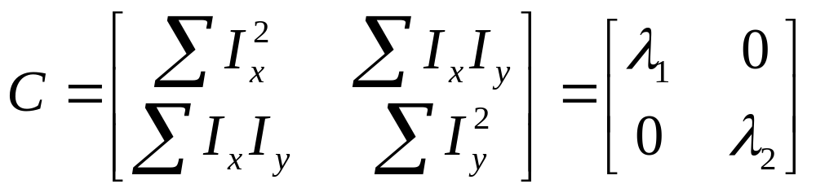
Eigenvalue Analysis – simple case
First, consider case where:
This means dominant gradient directions align with x or y axis
If either λ is close to 0, then this is not a corner, so look for locations where both are large.
Slide credit: David Jacobs

Slide 16
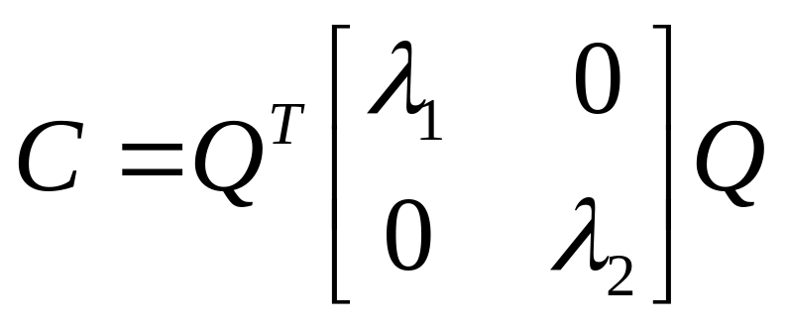
General Case
It can be shown that since C is symmetric:
So every case is like a rotated version of the one on last slide.
(λ_{max})^{-1/2}
(λ_{min})^{-1/2}

Slide 17
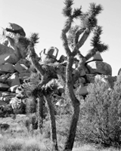
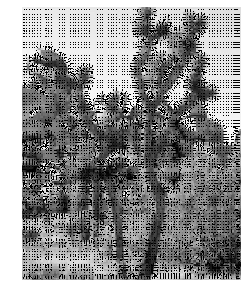
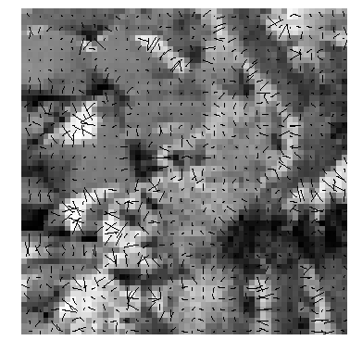
Gradient Orientation
Closeup

Slide 18
Corner Detection Summary
  if the area is a region of constant intensity, both eigenvalues will be very small.
  if it contains an edge, there will be one large and one small eigenvalue (the eigenvector associated with the large eigenvalue will be parallel to the image gradient).
  if it contains edges at two or more orientations (i.e., a corner), there will be two large eigenvalues (the eigenvectors will be parallel to the image gradients).

Slide 19
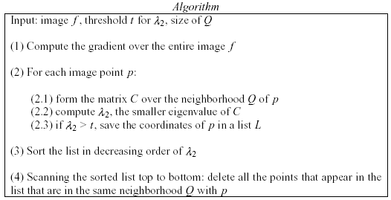
Corner Detection Algorithm

